Slide 1
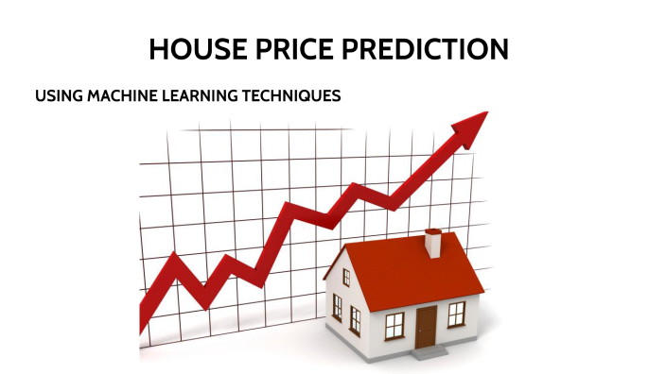
Name :- Dilip Verma
Institute :- IT Vedant
Branch :- Thane

Slide 2
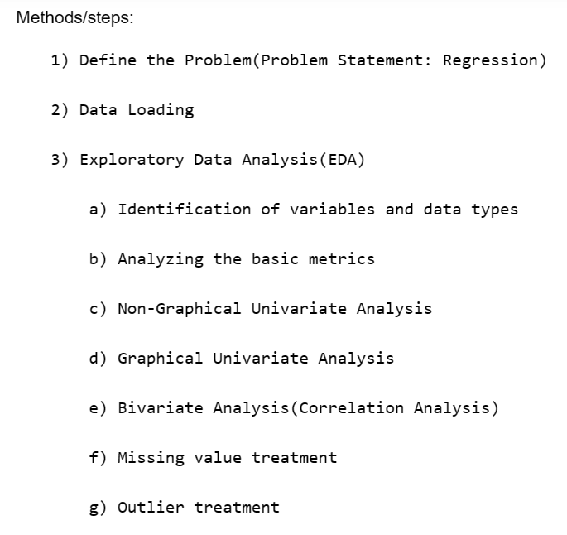
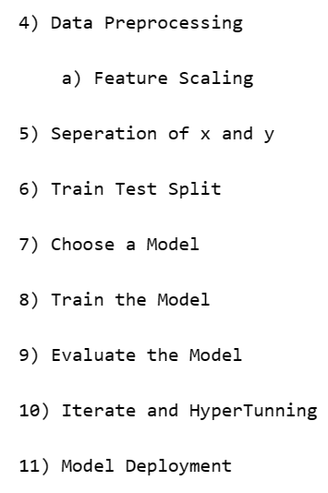
Steps

Slide 3

Problem Statement
A real state agents want the help to predict the house price for regions in the USA. He gave you the dataset to work on and the task is to create a model which will help him to estimate of what the house would sell for.

Slide 4
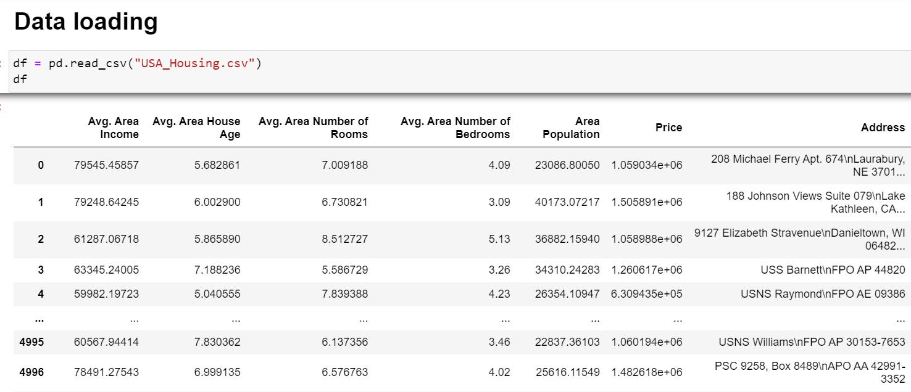
Data Collection
Description :-
Dataset contains 7 columns and 5000 rows with CSV extension. The data contains the following columns
'Avg. Area Income': Avg. Income of householder of the city house is located in.
'Avg. Area House Age': Avg. Age of Houses in same city.
'Avg. Area Number of Rooms': Avg. Number of Rooms for Houses in same city.
'Avg. Area Number of Bedrooms': Avg. Number of Bedrooms for Houses in same city.
'Area Population': Population of city.
'Price': Price that the house sold at.
'Address': Address of the houses.
Type of Data :- Continuous
Approach :- Supervised and Regression
Data Source :- GitHub

Slide 5
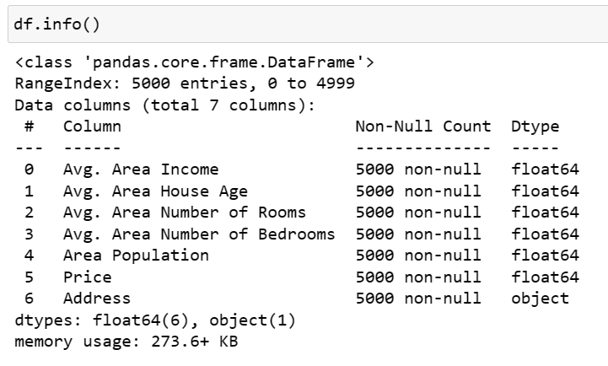
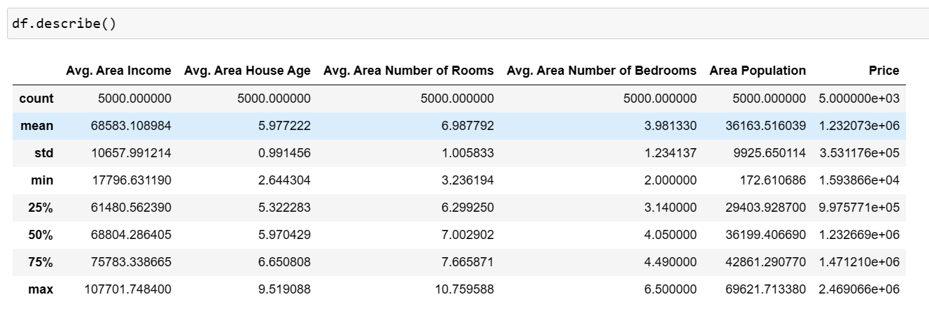
EDA
Identification of variables and data types
Non-Graphical Univariate Analysis

Slide 6
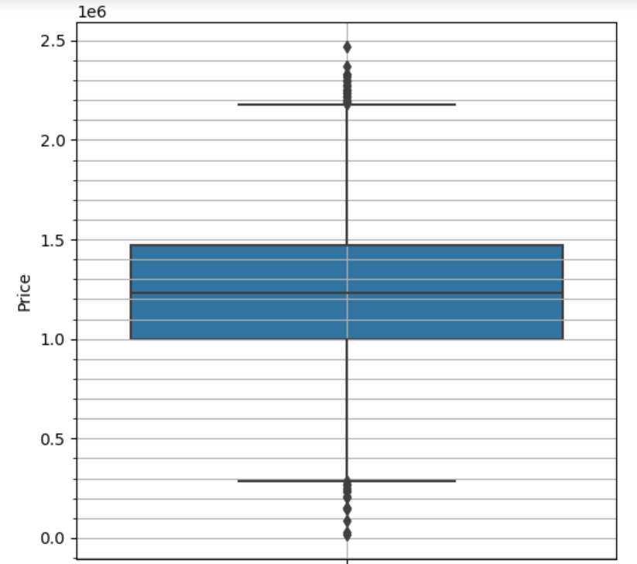
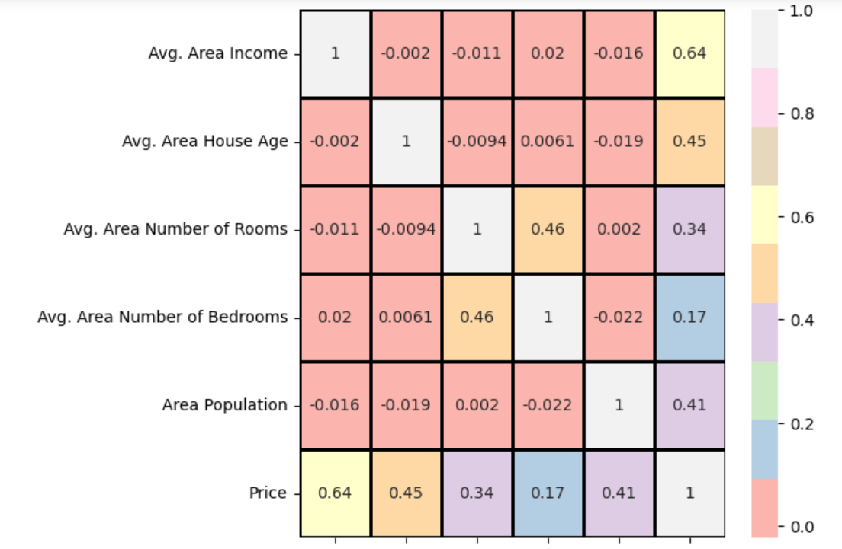
Graphical Univariate Analysis
Graphical Bivariate Analysis
Before Outlier Removal

Slide 7
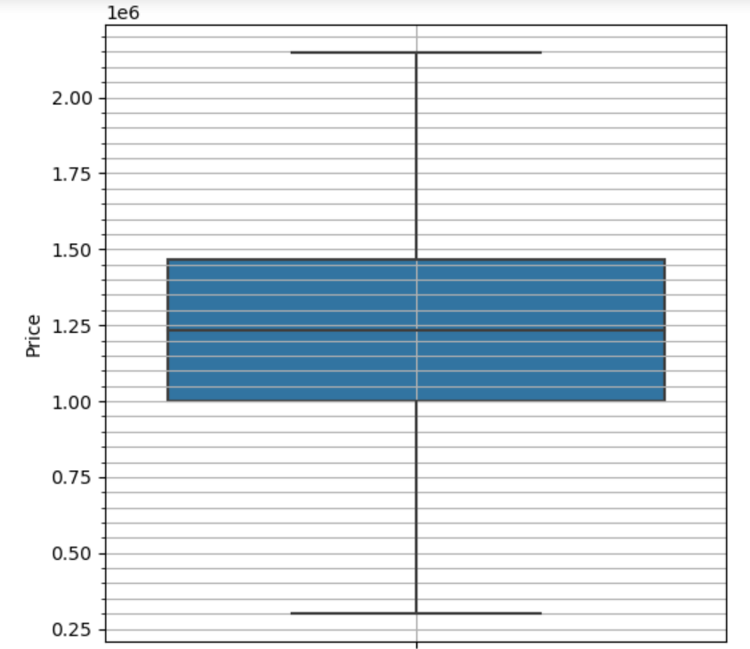
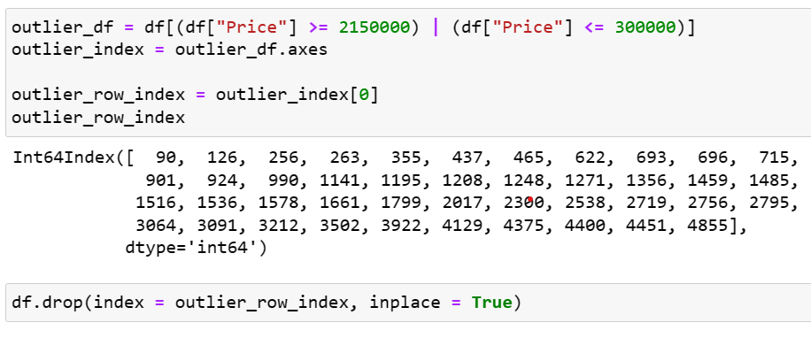
Graphical Univariate Analysis
Code for Outlier Detection and removal
After Outlier Removal

Slide 8
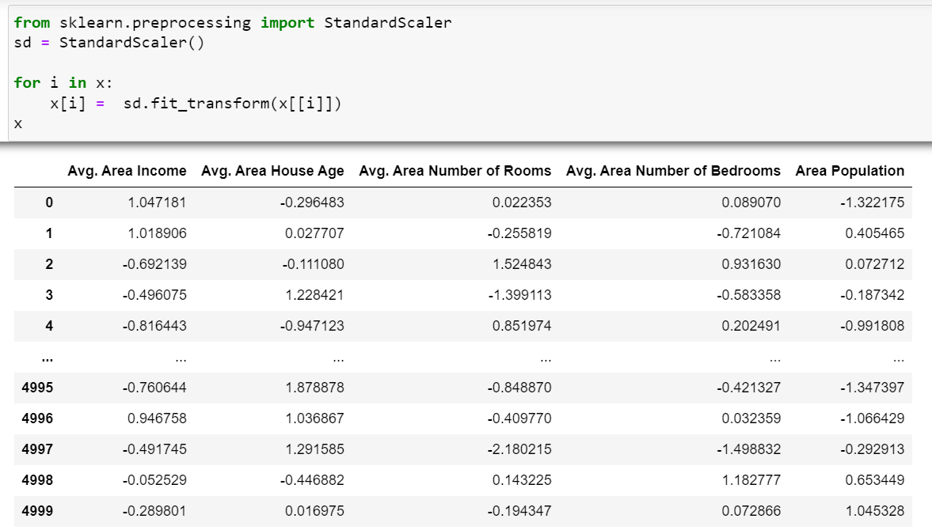
Data Preprocessing
Scaled Values
Preprocessing Step :- Feature Scaling (Standard Scaler)
Need :-
Machine Learning algorithms don’t understand unit concept.
To Scale Down all the Values in similar range.
To avoid biasing in model.
To avoid penalizing issue in hyper tunning.
Benefits :- Improves the accuracy of the model.

Slide 9
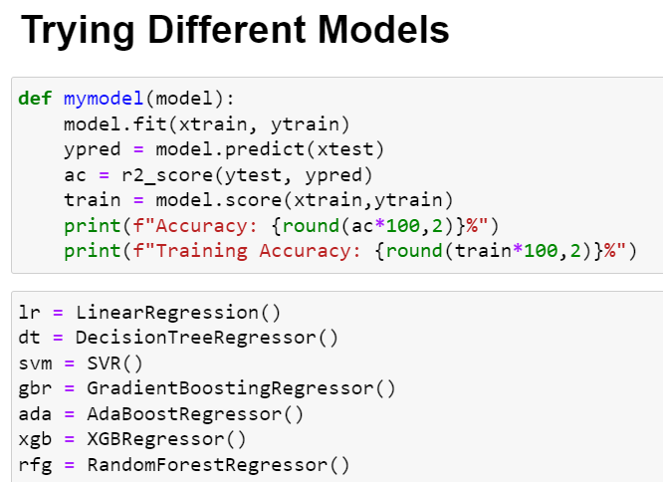
Model Selection and Training
Model selected :- Regression models

Slide 10
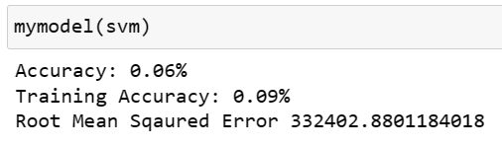

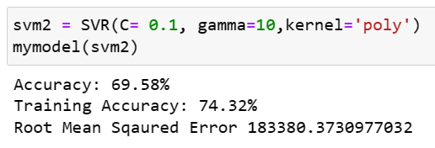
Model Evaluation
Evaluation Metrics :- r2_score, RMSE
Before Hyper Tunning
Grid Search Hyper Tunning (Automatic)
Best Values for Parameters
After Hyper Tunning

Slide 11
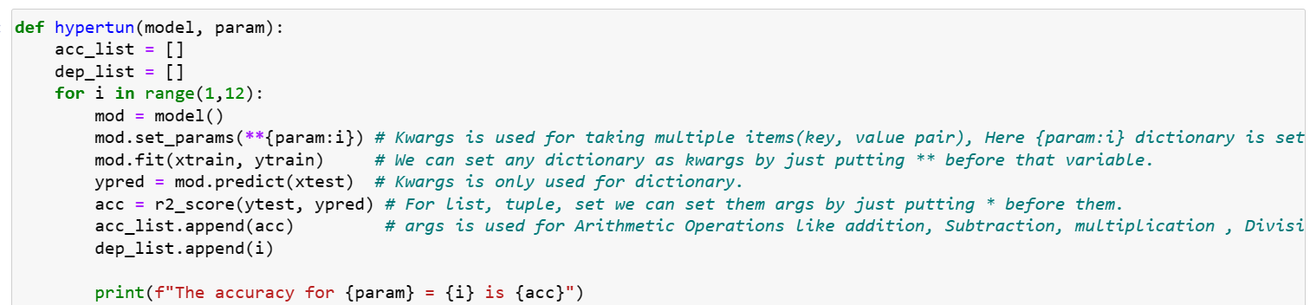
Hyper Tunning Through Define Function
Need :- To reduce the time consumption for Hyper Tunning , Grid Search takes More time when parameter and value are more, So we can pass one parameter at a time and model, and then just vary range for best accuracy of that parameter, do it for other parameters and take all the best value of respective parameters then used all the best values together.

Slide 12
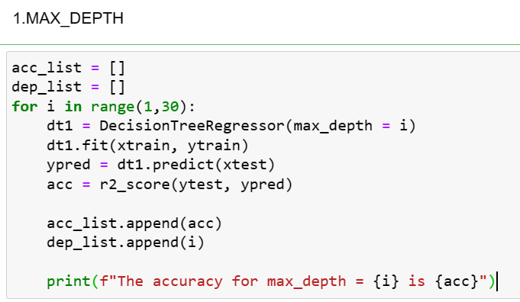
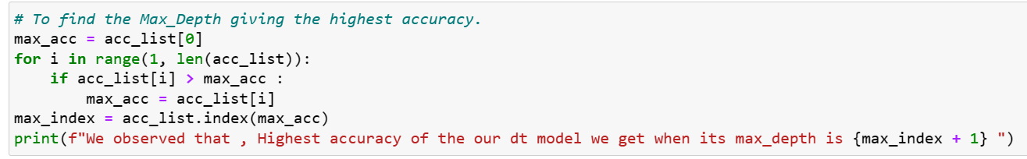
Manual Hyper Tunning For Decision Tree
We can do same for min samples leaf and min sample split.

Slide 13
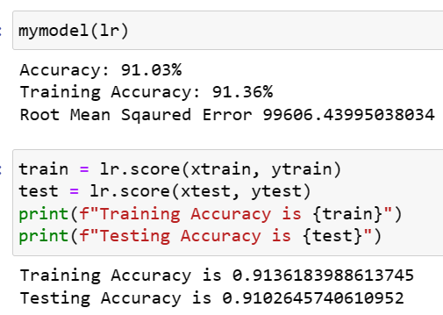
Conclusion
We will use linear model because it has the maximum accuracy(91.03%) and it is also good fit.

Slide 14

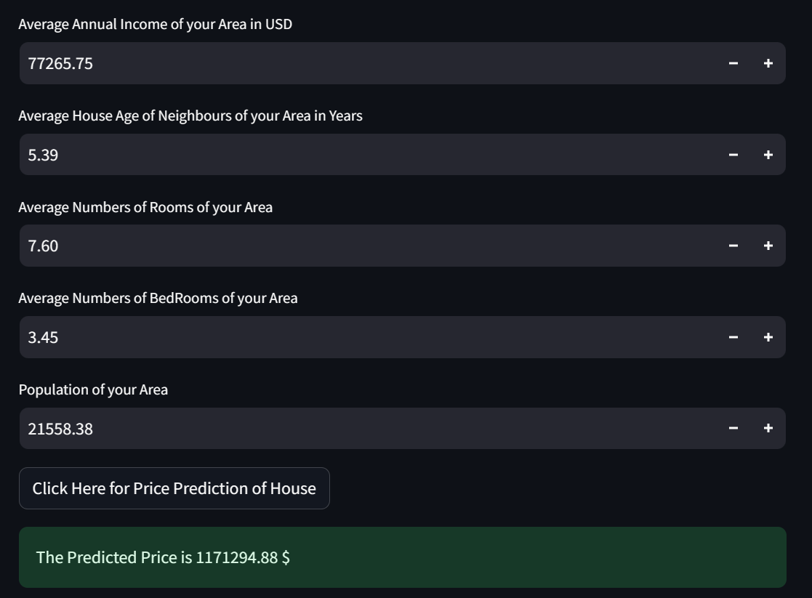
Deployment
Tools and Libraries used-
Anaconda Navigator : Environment Creation
Pickle : Binary Conversion of data
Stream lit : Web App
Scikit-Learn : Linear Model

Slide 15


